Slide 1


STREAMING PLATFORMS DATA ANALYSIS & INSIGHTS
By: Maryam Shaikh

Slide 2



DASHBOARDS
NETFLIX
AMAZON PRIME
DISNEY+HOTSTAR

Slide 3
OBJECTIVE
Goal:
To analyze popular streaming platforms (Netflix, Amazon Prime Video, and Disney+ Hotstar) to understand:
  Content distribution by type (Movies/Series)
  Duration trends
  Genre preferences
  Yearly release patterns
  Ratings and IMDB scores

Slide 4
DATA CLEANING & PREPARATION
  Removed null and duplicate values
  NULL:
Duration/Genre/Language
NETFLIX DATASET
BEFORE:
15481 rows
AFTER:
13480 rows

Slide 5
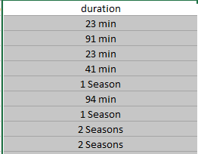
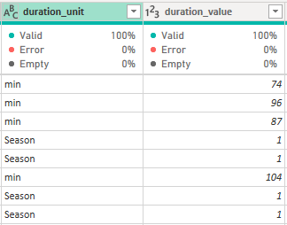
DATA CLEANING & PREPARATION
  Created new columns: duration_unit and duration_value
BEFORE:
AFTER:

Slide 6

DATA CLEANING & PREPARATION
  Filtered out rows only with valid types
  Keep rows Only with type = movie or tv show

Slide 7
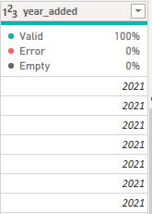
DATA CLEANING & PREPARATION
  Set correct data types ex (date_added → date type)
  From date_added extract year_added

Slide 8
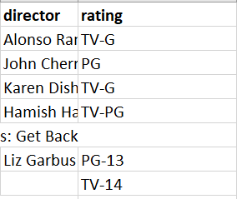
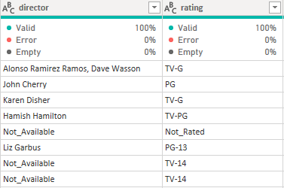
DATA CLEANING & PREPARATION
  Filled empty rows with not_rated or not_available
BEFORE:
AFTER:

Slide 9
NETFLIX DASHBOARD OVERVIEW
Highlights:
  Average IMDB Score: 6.49
  Top Duration Range: 1-2 hour (≈60%)
  Most Active Years: 2015 and 2020
  Dominant Genres: Comedy, Drama
  View Ratings: Mostly Not Rated and R rating
Insight: Netflix has a vast library with diverse genres, focusing more on long length content and mature audiences.

Slide 10
AMAZON PRIME DASHBOARD OVERVIEW
Highlights:
  Top Genres: Drama, Comedy, Suspense
  Yearly Releases: Increasing trend
  Rating Type: Wide distribution — from PG to 18+
Insight: Amazon Prime hosts a balanced mix with strong drama content and broader rating diversity.

Slide 11
DISNEY+HOTSTAR DASHBOARD OVERVIEW
Highlights:
  Average Minute Duration: 71 minutes
  Genre Focus: Family-friendly and Animation
  Top Ratings: TV-PG and TV-Y7 (children-oriented)
  Years: Major releases during 2019–2021
  Country Release: Most from USA
Insight: Disney+ Hotstar emphasizes family and kid-friendly content with moderate show durations.

Slide 12
THANK
you

